Slide 1
Language Models
Hongning Wang
CS@UVa

Slide 2
Recap: document generation model
Ignored for ranking
Model of relevant docs for Q
Model of non-relevant docs for Q
Assume independent attributes of A₁…A_{k} ….(why?)
Let D=d₁…d_{k}, where d_{k} ∈{0,1} is the value of attribute A_{k} (Similarly Q=q₁…q_{k} )
Terms occur in doc
Terms do not occur in doc
document | relevant(R=1) | nonrelevant(R=0)
term present A_{i}=1 | p_{i} | u_{i}
term absent A_{i}=0 | 1-p_{i} | 1-u_{i}

Slide 3
Recap: document generation model
Terms occur in doc
Terms do not occur in doc
Important tricks
Assumption: terms not occurring in the query are equally likely to occur in relevant and nonrelevant documents, i.e., p_{t}=u_{t}
document | relevant(R=1) | nonrelevant(R=0)
term present A_{i}=1 | p_{i} | u_{i}
term absent A_{i}=0 | 1-p_{i} | 1-u_{i}

Slide 4

Recap: Maximum likelihood vs. Bayesian
Maximum likelihood estimation
“Best” means “data likelihood reaches maximum”
Issue: small sample size
Bayesian estimation
“Best” means being consistent with our “prior” knowledge and explaining data well
A.k.a, Maximum a Posterior estimation
Issue: how to define prior?
$$\hat{θ}={argmax}_{θ}P(X|θ)$$
ML: Frequentist’s point of view
$$\hat{θ}={argmax_{θ}P\left(θ | X\right)=argmax}_{θ}P\left(X | θ\right)P(θ)$$
MAP: Bayesian’s point of view

Slide 5
Recap: Robertson-Sparck Jones Model (Robertson & Sparck Jones 76)
(RSJ model)
Two parameters for each term A_{i}:
p_{i} = P(A_{i}=1|Q,R=1): prob. that term A_{i} occurs in a relevant doc
u_{i} = P(A_{i}=1|Q,R=0): prob. that term A_{i} occurs in a non-relevant doc
How to estimate these parameters?
Suppose we have relevance judgments,
“+0.5” and “+1” can be justified by Bayesian estimation as priors
Per-query estimation!

Slide 6

Recap: the BM25 formula
TF-IDF component for document
TF component for query
A closer look
$b$ is usually set to [0.75, 1.2]
$k_{1}$is usually set to [1.2, 2.0]
$k_{2}$ is usually set to (0, 1000]
Vector space model with TF-IDF schema!

Slide 7
Notion of Relevance
Relevance
Δ(Rep(q), Rep(d))
Similarity
P(r=1|q,d) r ∈{0,1}
Probability of Relevance
P(d →q) or P(q →d)
Probabilistic inference
Regression
Model
(Fox 83)
Generative Model
Different
inference system
Different
rep & similarity
Doc
generation
Query
generation
…
Prob. concept
space model
(Wong & Yao, 95)
Inference
network
model
(Turtle & Croft, 91)
Vector space
model
(Salton et al., 75)
Prob. distr.
model
(Wong & Yao, 89)
Classical
prob. Model
(Robertson &
Sparck Jones, 76)
LM approach
(Ponte & Croft, 98)
(Lafferty & Zhai, 01a)

Slide 8
What is a statistical LM?
A model specifying probability distribution over word sequences
p(“Today is Wednesday”) ≈ 0.001
p(“Today Wednesday is”) ≈ 0.0000000000001
p(“The eigenvalue is positive”) ≈ 0.00001
It can be regarded as a probabilistic mechanism for “generating” text, thus also called a “generative” model

Slide 9
Why is a LM useful?
Provides a principled way to quantify the uncertainties associated with natural language
Allows us to answer questions like:
Given that we see “John” and “feels”, how likely will we see “happy” as opposed to “habit” as the next word?
(speech recognition)
Given that we observe “baseball” three times and “game” once in a news article, how likely is it about “sports”?
(text categorization, information retrieval)
Given that a user is interested in sports news, how likely would the user use “baseball” in a query?
(information retrieval)

Slide 10
Source-Channel framework ^{[Shannon 48]}
Source
Transmitter
(encoder)
Noisy
Channel
Receiver
(decoder)
Destination
X
Y
X’
P(X)
P(X|Y)=?
P(Y|X)
(Bayes Rule)
When X is text, p(X) is a language model
Many Examples:
Speech recognition: X=Word sequence Y=Speech signal
Machine translation: X=English sentence Y=Chinese sentence
OCR Error Correction: X=Correct word Y= Erroneous word
Information Retrieval: X=Document Y=Query
Summarization: X=Summary Y=Document

Slide 11

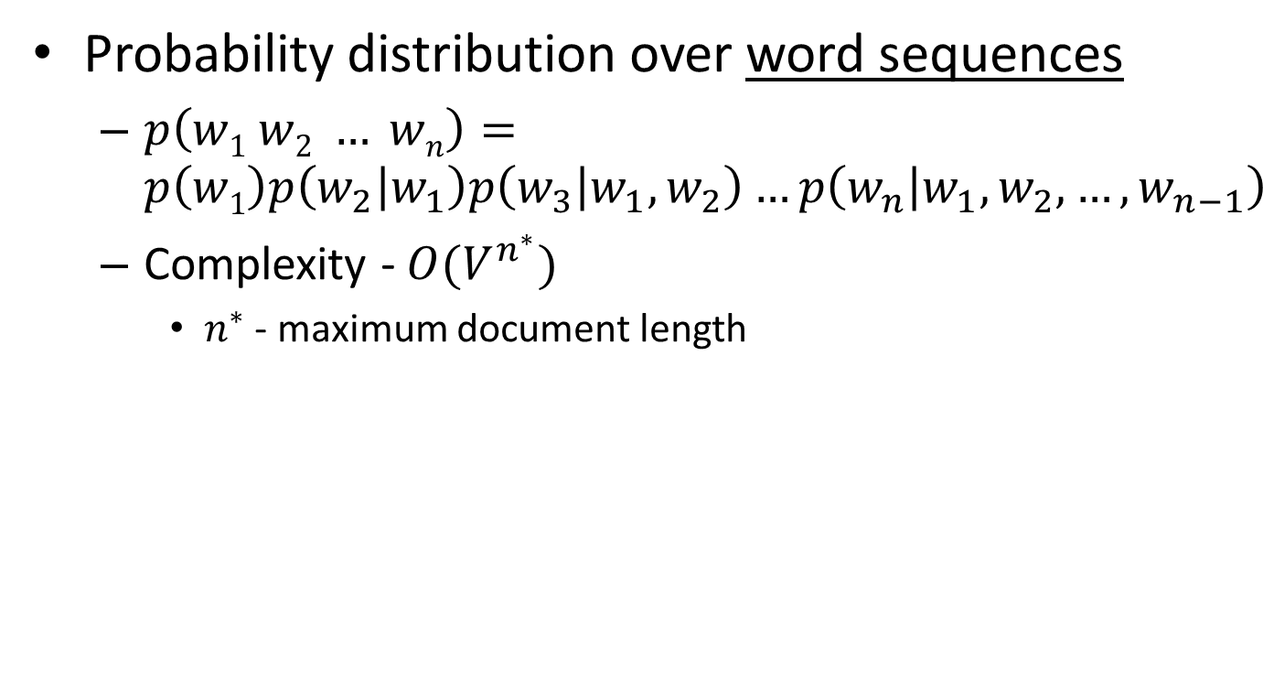

Language model for text
We need independence assumptions!
Probability distribution over word sequences
$p\left(w1 w2 … wn\right)=p\left(w1\right)p\left(w_{2} | w_{1}\right)p\left(w_{3} | w_{1},w_{2}\right)…p\left(w_{n} | w_{1},w_{2},…,w_{n−1}\right)$
Complexity - $O(V^{n^{∗}})$
$n^{∗}$ - maximum document length
sentence
Chain rule: from conditional probability to joint probability
475,000 main headwords in Webster's Third New International Dictionary
Average English sentence length is 14.3 words
A rough estimate: $O({475000}^{14})$
$$\frac{{475000}^{14}}{8bytes×{\left(1024\right)}^{4}}≈3.38e^{66}TB$$
How large is this?

Slide 12
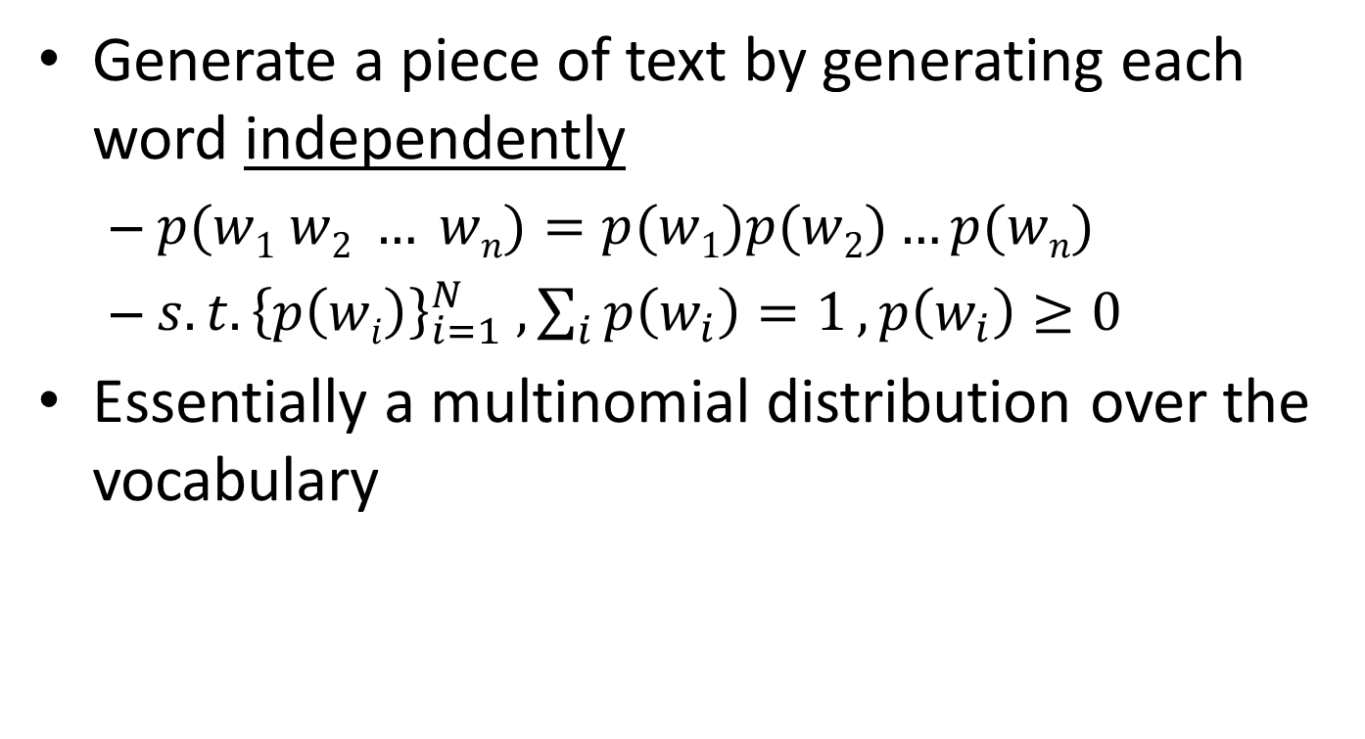
Unigram language model
Generate a piece of text by generating each word independently
$p(w1 w2 … wn)=p(w1)p(w2)…p(wn)$
${s.t. \left\{p\left(wi\right)\right\}}_{i=1}^{N} , \sum_{i}{p\left(w_{i}\right)=1}, p\left(w_{i}\right)≥0$
Essentially a multinomial distribution over the vocabulary
The simplest and most popular choice!

Slide 13
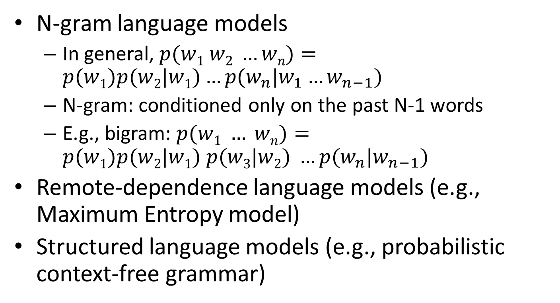
More sophisticated LMs
N-gram language models
In general, $p(w1 w2 …wn)=p(w1)p(w2|w1)…p(w_{n}|w_{1}…w_{n−1})$
N-gram: conditioned only on the past N-1 words
E.g., bigram: $p(w1 … wn)=p(w1)p(w2|w1) p(w3|w2) …p(w_{n}|w_{n−1})$
Remote-dependence language models (e.g., Maximum Entropy model)
Structured language models (e.g., probabilistic context-free grammar)

Slide 14
Why just unigram models?
Difficulty in moving toward more complex models
They involve more parameters, so need more data to estimate
They increase the computational complexity significantly, both in time and space
Capturing word order or structure may not add so much value for “topical inference”
But, using more sophisticated models can still be expected to improve performance ...

Slide 15
Generative view of text documents
(Unigram) Language Model θ
p(w| θ)
Sampling
Document
…
text 0.2
mining 0.1
assocation 0.01
clustering 0.02
…
food 0.00001
…
Topic 1:
Text mining
Text mining
document
…
text 0.01
food 0.25
nutrition 0.1
healthy 0.05
diet 0.02
…
Food nutrition
document
Topic 2:
Health

Slide 16
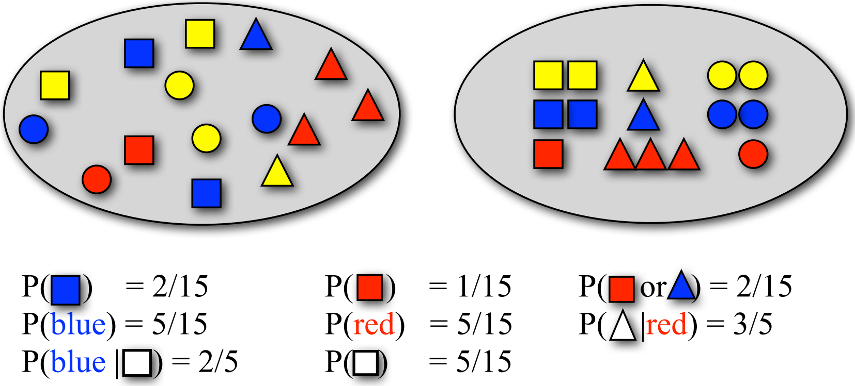
Sampling with replacement
Pick a random shape, then put it back in the bag

Slide 17

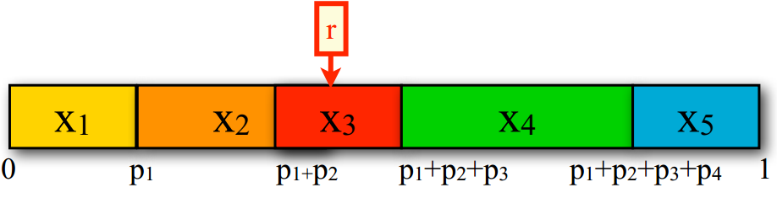

How to generate text document from an N-gram language model?
Sample from a discrete distribution $p(X)$
Assume $n$ outcomes in the event space $X$
Divide the interval [0,1] into $n$ intervals according to the probabilities of the outcomes
Generate a random number $r$ uniformly between 0 and 1
Return $x_{i}$ where $r$ falls into

Slide 18
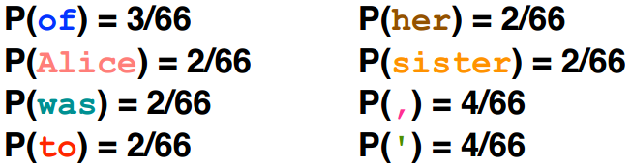
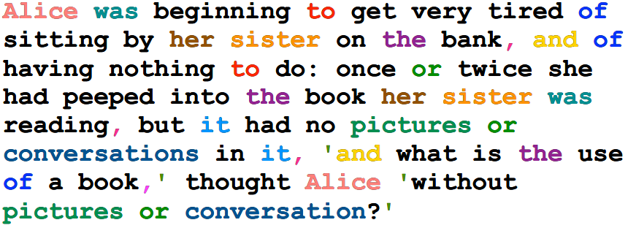
Generating text from language models
Under a unigram language model:

Slide 19
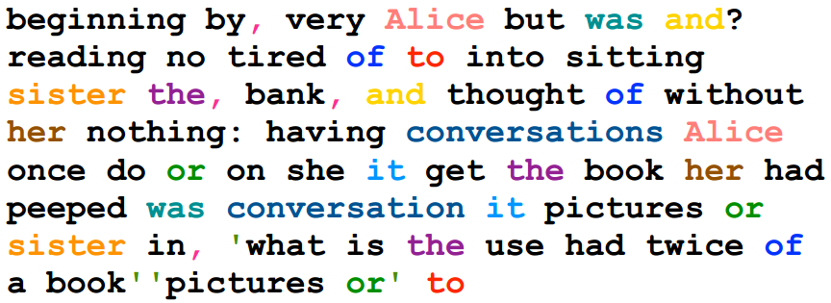
Generating text from language models
Under a unigram language model:
The same likelihood!

Slide 20
N-gram language models will help
Generated from language models of New York Times
Unigram
Months the my and issue of year foreign new exchange’s september were recession exchange new endorsed a q acquire to six executives.
Bigram
Last December through the way to preserve the Hudson corporation N.B.E.C. Taylor would seem to complete the major central planners one point five percent of U.S.E. has already told M.X. corporation of living on information such as more frequently fishing to keep her.
Trigram
They also point to ninety nine point six billon dollars from two hundred four oh six three percent of the rates of interest stores as Mexico and Brazil on market conditions.

Slide 21
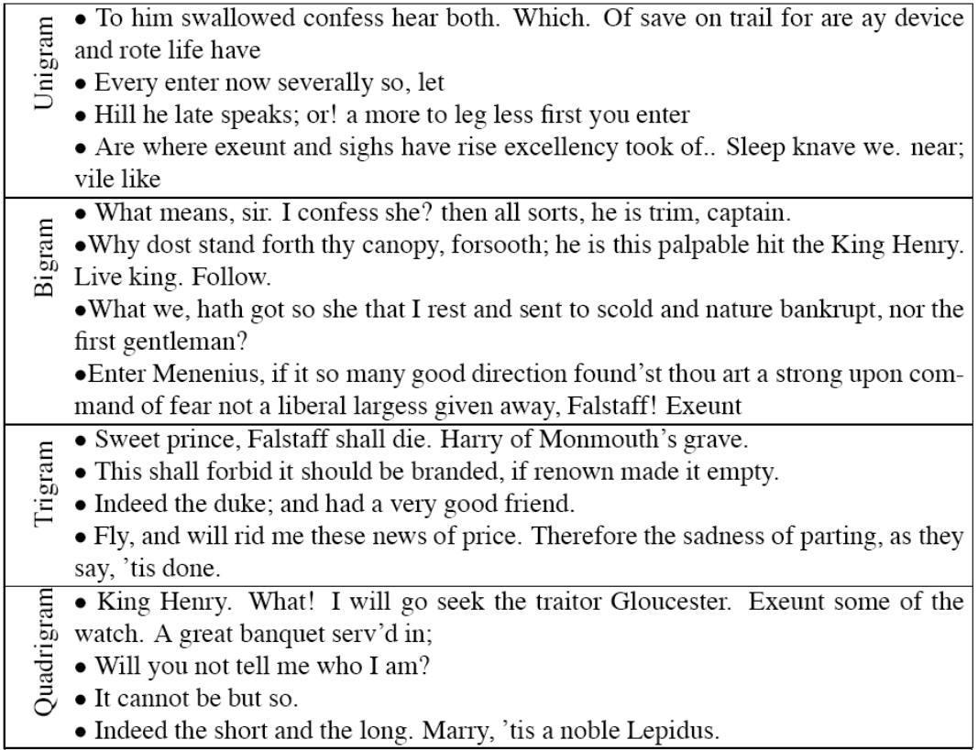

Turing test: generating Shakespeare
A
B
SCIgen - An Automatic CS Paper Generator
C
D

Slide 22
Recap: what is a statistical LM?
A model specifying probability distribution over word sequences
p(“Today is Wednesday”) ≈ 0.001
p(“Today Wednesday is”) ≈ 0.0000000000001
p(“The eigenvalue is positive”) ≈ 0.00001
It can be regarded as a probabilistic mechanism for “generating” text, thus also called a “generative” model

Slide 23
Recap: Source-Channel framework ^{[Shannon 48]}
Source
Transmitter
(encoder)
Noisy
Channel
Receiver
(decoder)
Destination
X
Y
X’
P(X)
P(X|Y)=?
P(Y|X)
(Bayes Rule)
When X is text, p(X) is a language model
Many Examples:
Speech recognition: X=Word sequence Y=Speech signal
Machine translation: X=English sentence Y=Chinese sentence
OCR Error Correction: X=Correct word Y= Erroneous word
Information Retrieval: X=Document Y=Query
Summarization: X=Summary Y=Document

Slide 24
Recap: language model for text
We need independence assumptions!
Probability distribution over word sequences
$p\left(w1 w2 … wn\right)=p\left(w1\right)p\left(w_{2} | w_{1}\right)p\left(w_{3} | w_{1},w_{2}\right)…p\left(w_{n} | w_{1},w_{2},…,w_{n−1}\right)$
Complexity - $O(V^{n^{∗}})$
$n^{∗}$ - maximum document length
sentence
Chain rule: from conditional probability to joint probability
475,000 main headwords in Webster's Third New International Dictionary
Average English sentence length is 14.3 words
A rough estimate: $O({475000}^{14})$
$$\frac{{475000}^{14}}{8bytes×{\left(1024\right)}^{4}}≈3.38e^{66}TB$$
How large is this?

Slide 25
Recap: how to generate text document from an N-gram language model?
Sample from a discrete distribution $p(X)$
Assume $n$ outcomes in the event space $X$
Divide the interval [0,1] into $n$ intervals according to the probabilities of the outcomes
Generate a random number $r$ uniformly between 0 and 1
Return $x_{i}$ where $r$ falls into

Slide 26
Estimation of language models
Unigram Language Model θ
p(w| θ)=?
Estimation
Document
…
text ?
mining ?
assocation ?
database ?
…
query ?
…
text 10
mining 5
association 3
database 3
algorithm 2
…
query 1
efficient 1
A “text mining” paper
(total #words=100)

Slide 27
Sampling with replacement
Pick a random shape, then put it back in the bag

Slide 28
Estimation of language models
Maximum likelihood estimation
Unigram Language Model θ
p(w| θ)=?
Estimation
Document
…
text ?
mining ?
assocation ?
database ?
…
query ?
…
text 10
mining 5
association 3
database 3
algorithm 2
…
query 1
efficient 1
10/100
5/100
3/100
3/100
1/100
A “text mining” paper
(total #words=100)

Slide 29

Maximum likelihood estimation
For N-gram language models
$p\left(w_{i} | w_{i−n+1},…,w_{i−1}\right)=\frac{c(w_{i−n+1},…,w_{i−1},w_{i})}{c(w_{i−n+1},…,w_{i−1})}$
$c\left(∅\right)=N$
Length of document or total number of words in a corpus

Slide 30
Language models for IR ^{[Ponte & Croft SIGIR’98]}
Document
Language Model
Query
…
text ?
mining ?
assocation ?
clustering ?
…
food ?
…
Text mining
paper
?
“data mining algorithms”
…
food ?
nutrition ?
healthy ?
diet ?
…
Food nutrition
paper
Which model would most
likely have generated this query?

Slide 31
Ranking docs by query likelihood
Doc LM
Query likelihood
d₁
θ_{d1}
p(q| θ_{d1})
q
d₂
θ_{d2}
p(q| θ_{d2})
……
……
p(q| θ_{dN})
d_{N}
θ_{dN}
Justification: PRP

Slide 32
Justification from PRP
Query generation
Query likelihood p(q| θ_{d})
Document prior
Assuming uniform document prior, we have

Slide 33
Retrieval as language model estimation
Document ranking based on query likelihood
Retrieval problem ≈ Estimation of $p(wi|d)$
Common approach
Maximum likelihood estimation (MLE)
Document language model

Slide 34
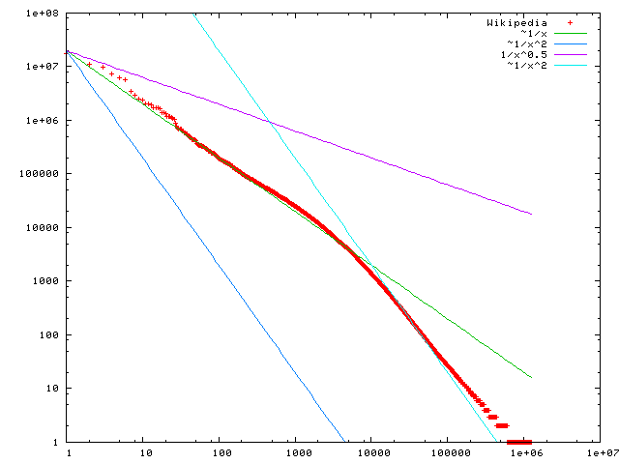

Problem with MLE
Unseen events
There are 440K tokens on a larger collection of Yelp reviews, but:
Only 30,000 unique words occurred
Only 0.04% of all possible bigrams occurred
This means any word/N-gram that does not occur in the collection has zero probability with MLE!
No future documents can contain those unseen words/N-grams
$$f\left(k;s,N\right)∝1/k^{s}$$
Word frequency
Word rank by frequency
A plot of word frequency in Wikipedia (Nov 27, 2006)

Slide 35
Problem with MLE
What probability should we give a word that has not been observed in the document?
log0?
If we want to assign non-zero probabilities to such words, we’ll have to discount the probabilities of observed words
This is so-called “smoothing”

Slide 36
General idea of smoothing
All smoothing methods try to
Discount the probability of words seen in a document
Re-allocate the extra counts such that unseen words will have a non-zero count

Slide 37
Illustration of language model smoothing
P(w|d)
Max. Likelihood Estimate
Smoothed LM
w
Discount from the seen words
Assigning nonzero probabilities to the unseen words

Slide 38
Smoothing methods
Method 1: Additive smoothing
Add a constant δ to the counts of each word
Problems?
Hint: all words are equally important?
Counts of w in d
“Add one”, Laplace smoothing
Vocabulary size
Length of d (total counts)

Slide 39
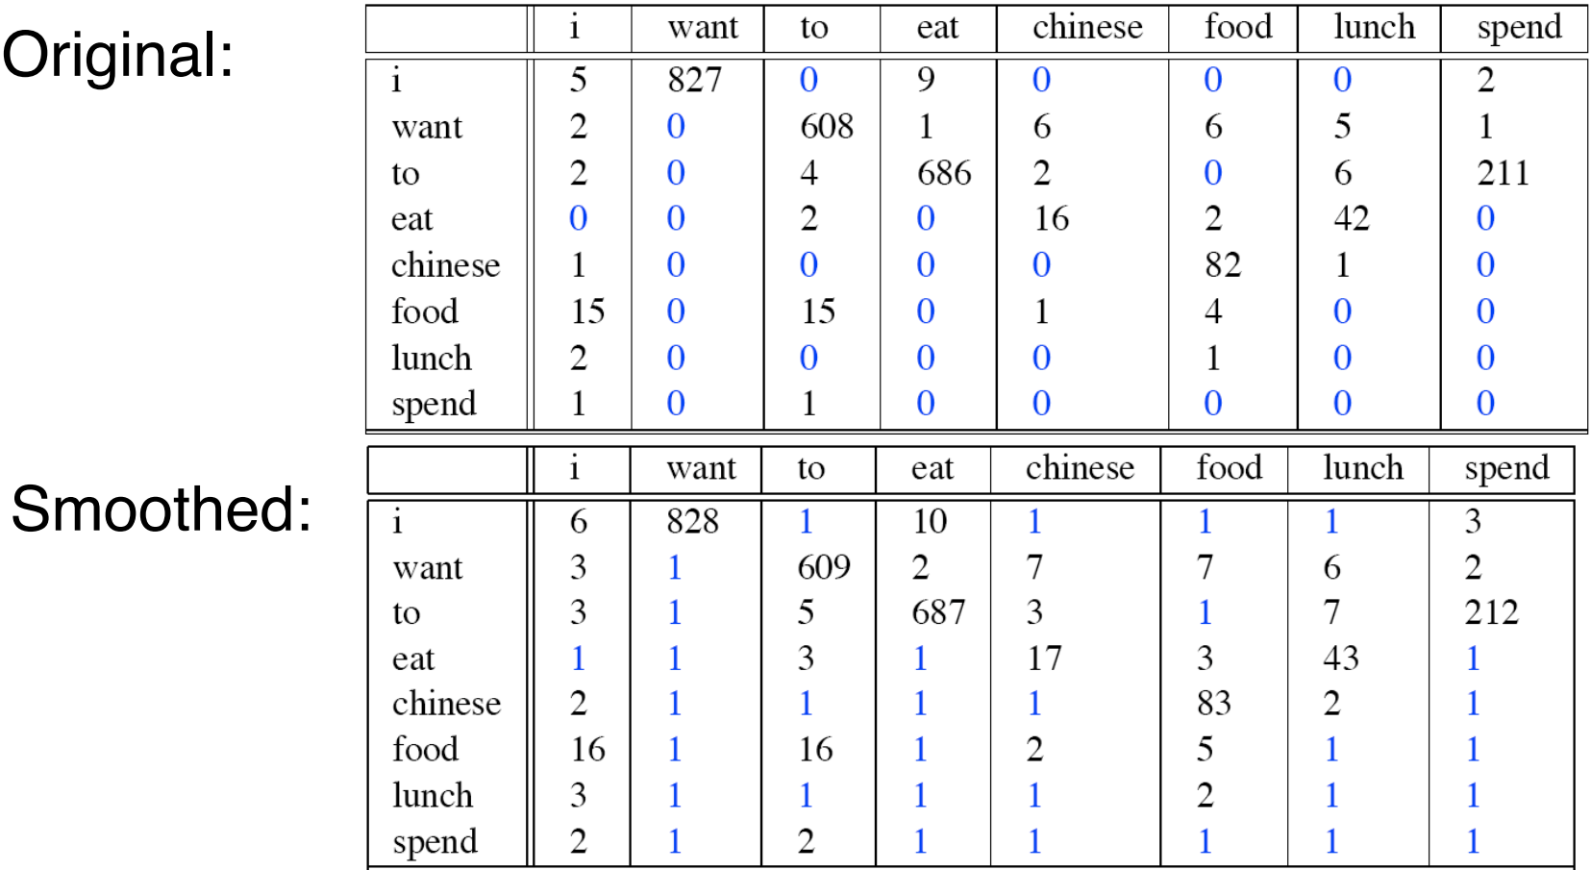
Add one smoothing for bigrams

Slide 40
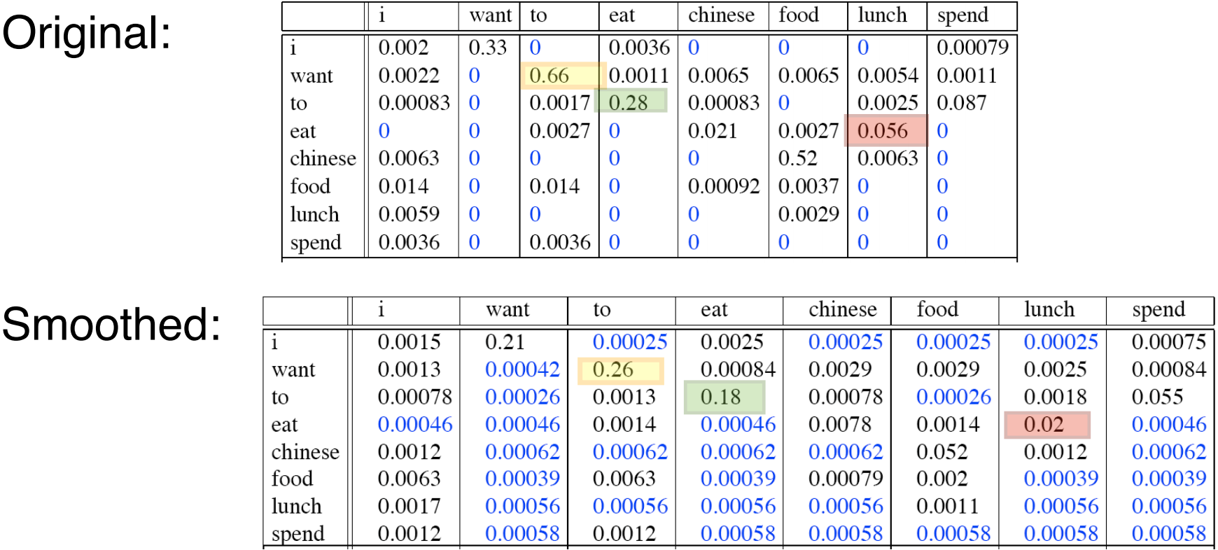
After smoothing
Giving too much to the unseen events

Slide 41
Refine the idea of smoothing
Should all unseen words get equal probabilities?
We can use a reference model to discriminate unseen words
Discounted ML estimate
Reference language model

Slide 42
Smoothing methods
Method 2: Absolute discounting
Subtract a constant δ from the counts of each word
Problems?
Hint: varied document length?
# uniq words

Slide 43
Smoothing methods
Method 3: Linear interpolation, Jelinek-Mercer
“Shrink” uniformly toward p(w|REF)
Problems?
Hint: what is missing?
parameter
MLE

Slide 44
Smoothing methods
Method 4: Dirichlet Prior/Bayesian
Assume pseudo counts μp(w|REF)
Problems?
parameter

Slide 45
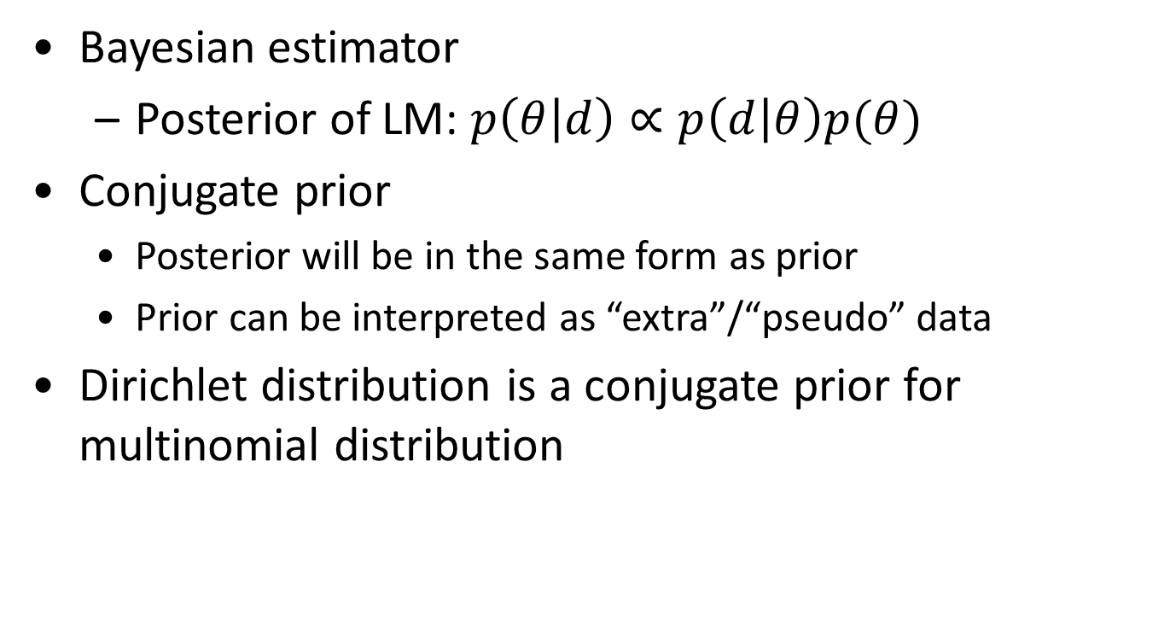
Dirichlet prior smoothing
likelihood of doc given the model
Bayesian estimator
Posterior of LM: $p\left(θ | d\right)∝p\left(d | θ\right)p(θ)$
Conjugate prior
Posterior will be in the same form as prior
Prior can be interpreted as “extra”/“pseudo” data
Dirichlet distribution is a conjugate prior for multinomial distribution
prior over models
“extra”/“pseudo” word counts, we set α_{i}=μ p(w_{i}|REF)

Slide 46
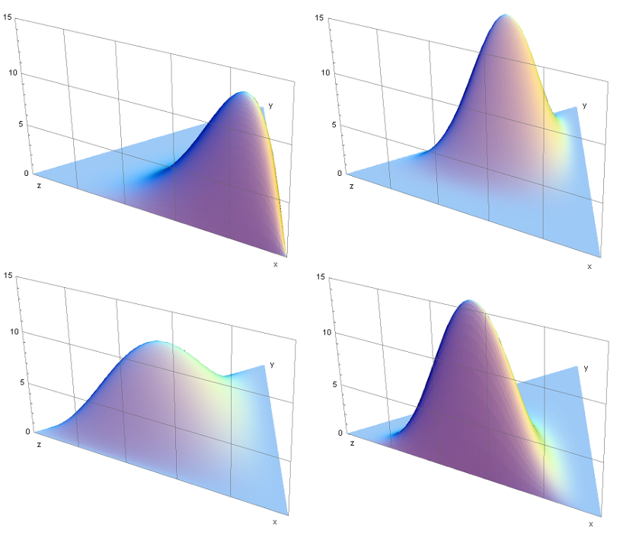
Some background knowledge
Conjugate prior
Posterior dist in the same family as prior
Dirichlet distribution
Continuous
Samples from it will be the parameters in a multinomial distribution
Gaussian -> Gaussian
Beta -> Binomial
Dirichlet -> Multinomial

Slide 47
Dirichlet prior smoothing (cont)
Posterior distribution of parameters:
The predictive distribution is the same as the mean:
Dirichlet prior smoothing

Slide 48
Estimating μ using leave-one-out ^{[Zhai & Lafferty 02]}
w₁
Leave-one-out
P(w₁|d_{- w1})
log-likelihood
w₂
P(w₂|d_{- w2})
Maximum Likelihood Estimator
...
w_{n}
P(w_{n}|d_{- wn})

Slide 49
Why would “leave-one-out” work?
20 word by author1
abc abc ab c d d
abc cd d d
abd ab ab ab ab
cd d e cd e
Now, suppose we leave “e” out…
μ doesn’t have to be big
20 word by author2
abc abc ab c d d
abe cb e f
acf fb ef aff abef
cdc db ge f s
μ must be big! more smoothing
The amount of smoothing is closely related to
the underlying vocabulary size

Slide 50
Recap: ranking docs by query likelihood
Doc LM
Query likelihood
d₁
θ_{d1}
p(q| θ_{d1})
q
d₂
θ_{d2}
p(q| θ_{d2})
……
……
p(q| θ_{dN})
d_{N}
θ_{dN}
Justification: PRP

Slide 51
Recap: retrieval as language model estimation
Document ranking based on query likelihood
Retrieval problem ≈ Estimation of $p(wi|d)$
Common approach
Maximum likelihood estimation (MLE)
Document language model

Slide 52
Recap: illustration of language model smoothing
P(w|d)
Max. Likelihood Estimate
Smoothed LM
w
Discount from the seen words
Assigning nonzero probabilities to the unseen words

Slide 53
Recap: smoothing methods
Method 1: Additive smoothing
Add a constant δ to the counts of each word
Problems?
Hint: all words are equally important?
Counts of w in d
“Add one”, Laplace smoothing
Vocabulary size
Length of d (total counts)

Slide 54
Recap: refine the idea of smoothing
Should all unseen words get equal probabilities?
We can use a reference model to discriminate unseen words
Discounted ML estimate
Reference language model

Slide 55
Recap: smoothing methods
Method 2: Absolute discounting
Subtract a constant δ from the counts of each word
Problems?
Hint: varied document length?
# uniq words

Slide 56
Recap: smoothing methods
Method 3: Linear interpolation, Jelinek-Mercer
“Shrink” uniformly toward p(w|REF)
Problems?
Hint: what is missing?
parameter
MLE

Slide 57
Recap: smoothing methods
Method 4: Dirichlet Prior/Bayesian
Assume pseudo counts μp(w|REF)
Problems?
parameter

Slide 58




Recap: understanding smoothing
Topical words
Query = “the algorithms for data mining”
p_{ML}(w|d1): 0.04 0.001 0.02 0.002 0.003
p_{ML}(w|d2): 0.02 0.001 0.01 0.003 0.004
$$4.8×{10}^{−12}$$
$$2.4×{10}^{−12}$$
p( “algorithms”|d1) = p(“algorithms”|d2)
p( “data”|d1) < p(“data”|d2)
p( “mining”|d1) < p(“mining”|d2)
Intuitively, d2 should have a higher score,
but p(q|d1)>p(q|d2)…
So we should make p(“the”) and p(“for”) less different for all docs,
and smoothing helps to achieve this goal…
$$2.35×{10}^{−13}$$
$$4.53×{10}^{−13}$$
Query = “the algorithms for data mining”
P(w|REF) 0.2 0.00001 0.2 0.00001 0.00001
Smoothed p(w|d1): 0.184 0.000109 0.182 0.000209 0.000309
Smoothed p(w|d2): 0.182 0.000109 0.181 0.000309 0.000409

Slide 59
Two-stage smoothing ^{[Zhai & Lafferty 02]}
Stage-1
-Explain unseen words
-Dirichlet prior (Bayesian)
Stage-2
-Explain noise in query
-2-component mixture
μ
λ
Collection LM
c(w,d)
+μp(w|C)
P(w|d) =
(1-λ)
+ λp(w|U)
|d|
+μ
User background model

Slide 60
Understanding smoothing
Plug in the general smoothing scheme to the query likelihood retrieval formula, we obtain
Doc length normalization
(longer doc is expected to have a smaller α_{d})
TF weighting
IDF weighting
Ignore for ranking
Smoothing with p(w|C) ≈ TF-IDF + doc-length normalization

Slide 61
Smoothing & TF-IDF weighting
Smoothed ML estimate
Retrieval formula using the general smoothing scheme
Reference language model
$$c\left(w,q\right)>0$$
Key rewriting step (where did we see it before?)
Similar rewritings are very common when using probabilistic models for IR…

Slide 62
What you should know
How to estimate a language model
General idea and different ways of smoothing
Effect of smoothing

Slide 63
Today’s reading
Introduction to information retrieval
Chapter 12: Language models for information retrieval

